Slide 1

Evaluating Prediction errors Nonparametrically and parametrically
José Pedro Gama de Sousa Rodrigues
202006455
Inferential Statistics

Slide 2


FPL Dataset
Game
628 observations & 16 Variables
Numerical
Categorical
Goals Scored
Assists
Cost
Points
Saves
Yellow Cards
Red cards
Minutes Played
TSB (% of teams possessing the player)
CS (number of clean sheets)
Shots on Target
Goals Conceded
BPS
Player Name
Player Team
Position

Slide 3
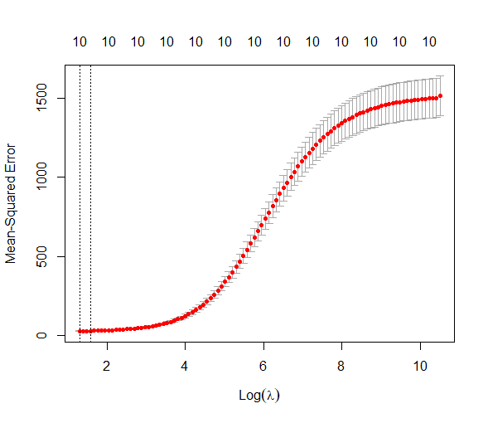
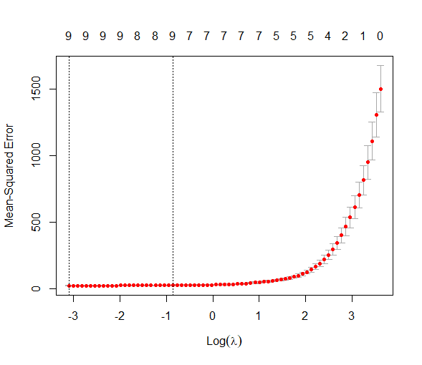
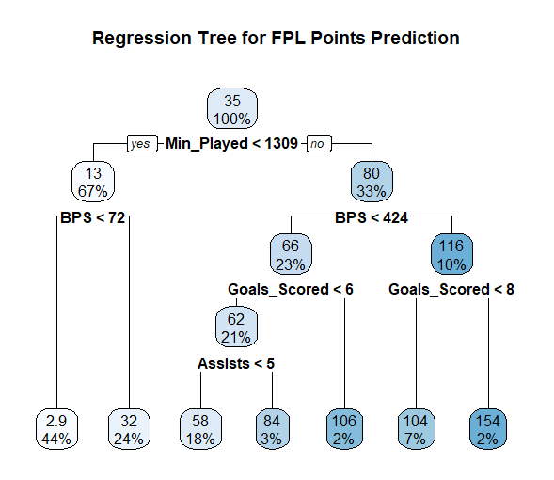

Prediction Rule
Ridge Regression
Multiple Linear Regression
$y= β_{0}+β_{1}X_{1}+…+β_{n}X_{n}+ ε$
Ridge Regression
Alpha = 0; Lambda = $6.434233$
${RSS}_{Ridge}= {∥Y−Xβ∥}^{2}+ λ{∥β∥}^{2}$
Lasso Regression
Alpha = 1; Lambda = $0.4233296$
${RSS}_{lasso}= {∥Y−Xβ∥}^{2}+ λ{∥β∥}_{1}$
Regression Trees
Lasso Regression

Slide 4
Non-Parameteric Analysis

Slide 5


Training Test Split
70:30 Split
LOOCV
N - 1
K-Fold CV
N/K Groups
K = 10

Slide 6
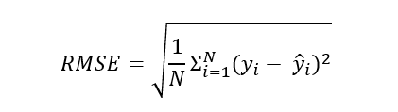


Error Evaluation
Root Mean Squared Error
R - Squared
Mean Absolute Error

Slide 7
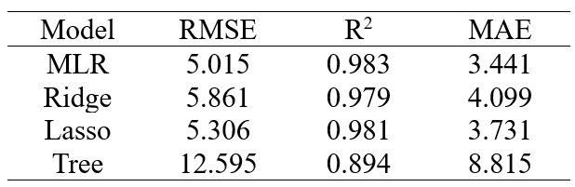
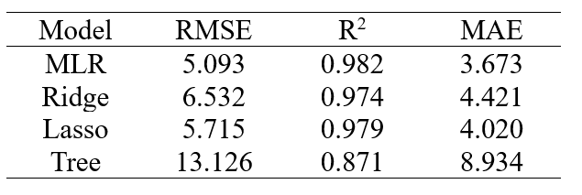
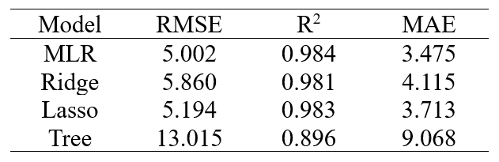
Results
LOO Cross- Validation
Train Test Set
10 – Fold Cross- Validation

Slide 8
Parametric Analysis

Slide 9
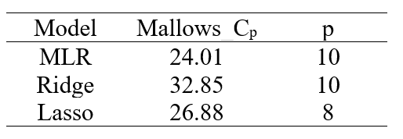

Mallows Cp
Results
New regression rule
$\hat{μ}=r\left(y\right)$
y ~ (𝝁,$σ^{2}$,𝑰)
Covariance Penalty lemma
$E\left\{{Err}_{i}\right\}=E\left\{{apparent error}_{i}\right\}+2cov\left({\hat{μ}}_{i},y_{i}\right)$
$Apparent {error}_{i}=(y_{i}−{\hat{μ}}_{i})^{2}$
Mallows Cp Formula
$\hat{Err}. = \frac{1}{N}Σ_{i=1}^{N}(y_{i}− {\hat{μ}}_{i})^{2}+ \frac{2}{N}σ^{2}p$
Degrees of Freedom
$df=(\frac{1}{σ^{2}})Σ_{i=1}^{N}\hat{cov}({\hat{μ}}_{i},y_{i})$

Slide 10
Conclusion
In both parametric and non-parametric methods Multiple linear regression seems to be the most accurate model
Nonparametric methods showed great results
Parametric methods suggested overfit models
Future work
A bigger variety of models
More parametric accuracy evaluation methods
Combination of both

